Slide 1
Jack of all trade universe
Online community marketplace
Community currency Generator
Presented by Jamie klinger

Slide 2
VISION
To build an economy that seeks to promote human welfare

Slide 3


Slide 4
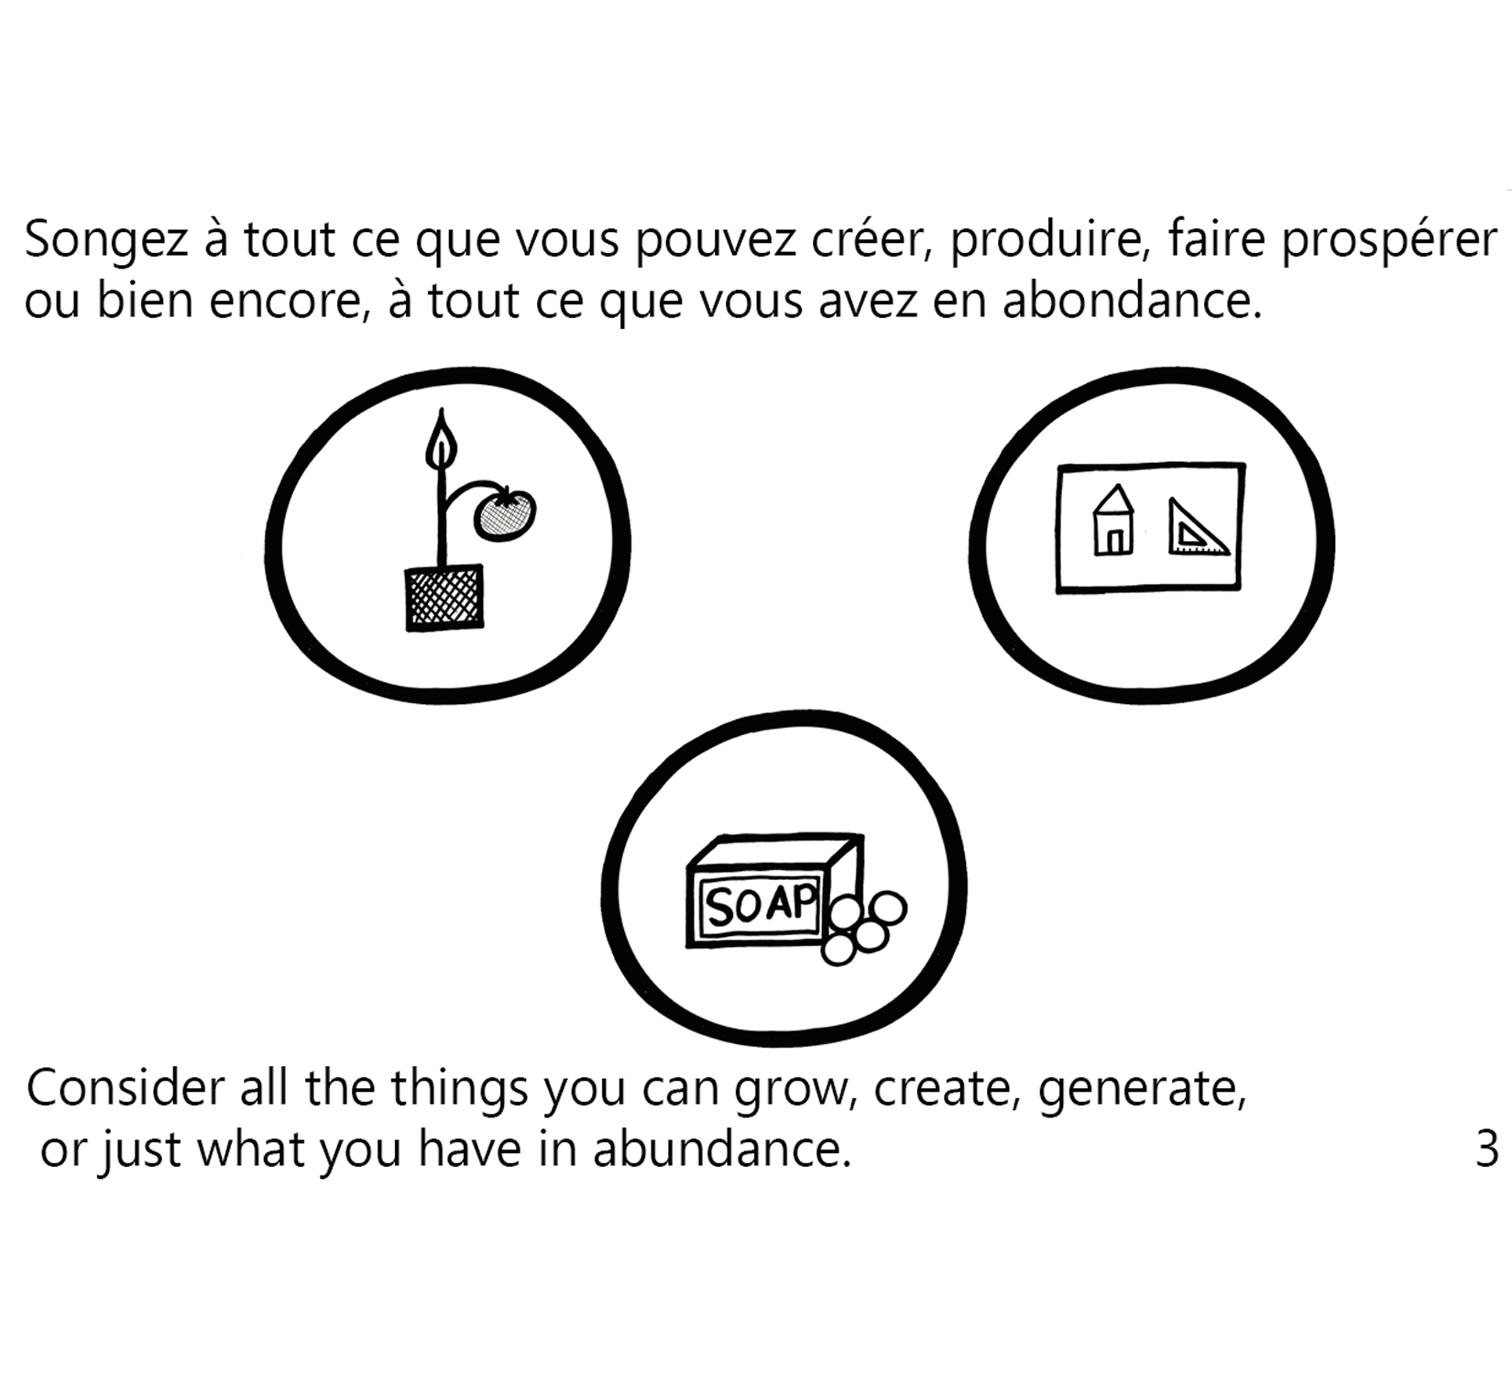

Slide 5
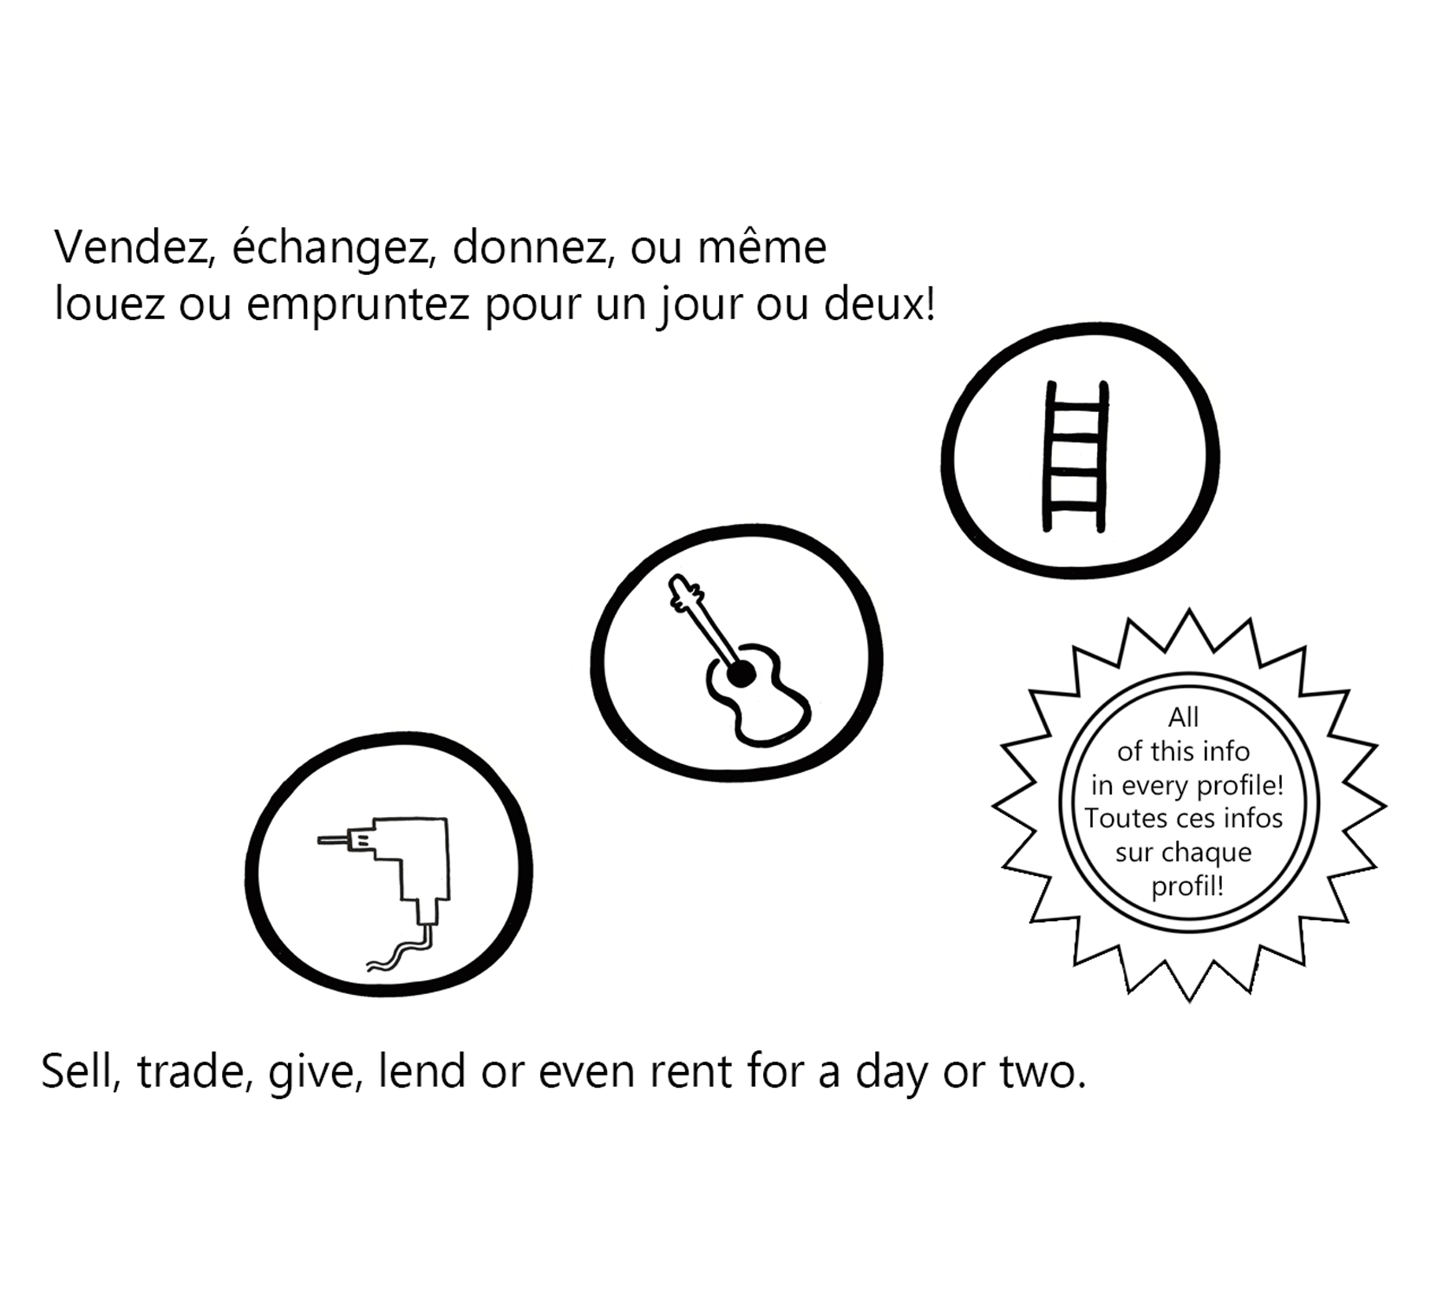

Slide 6
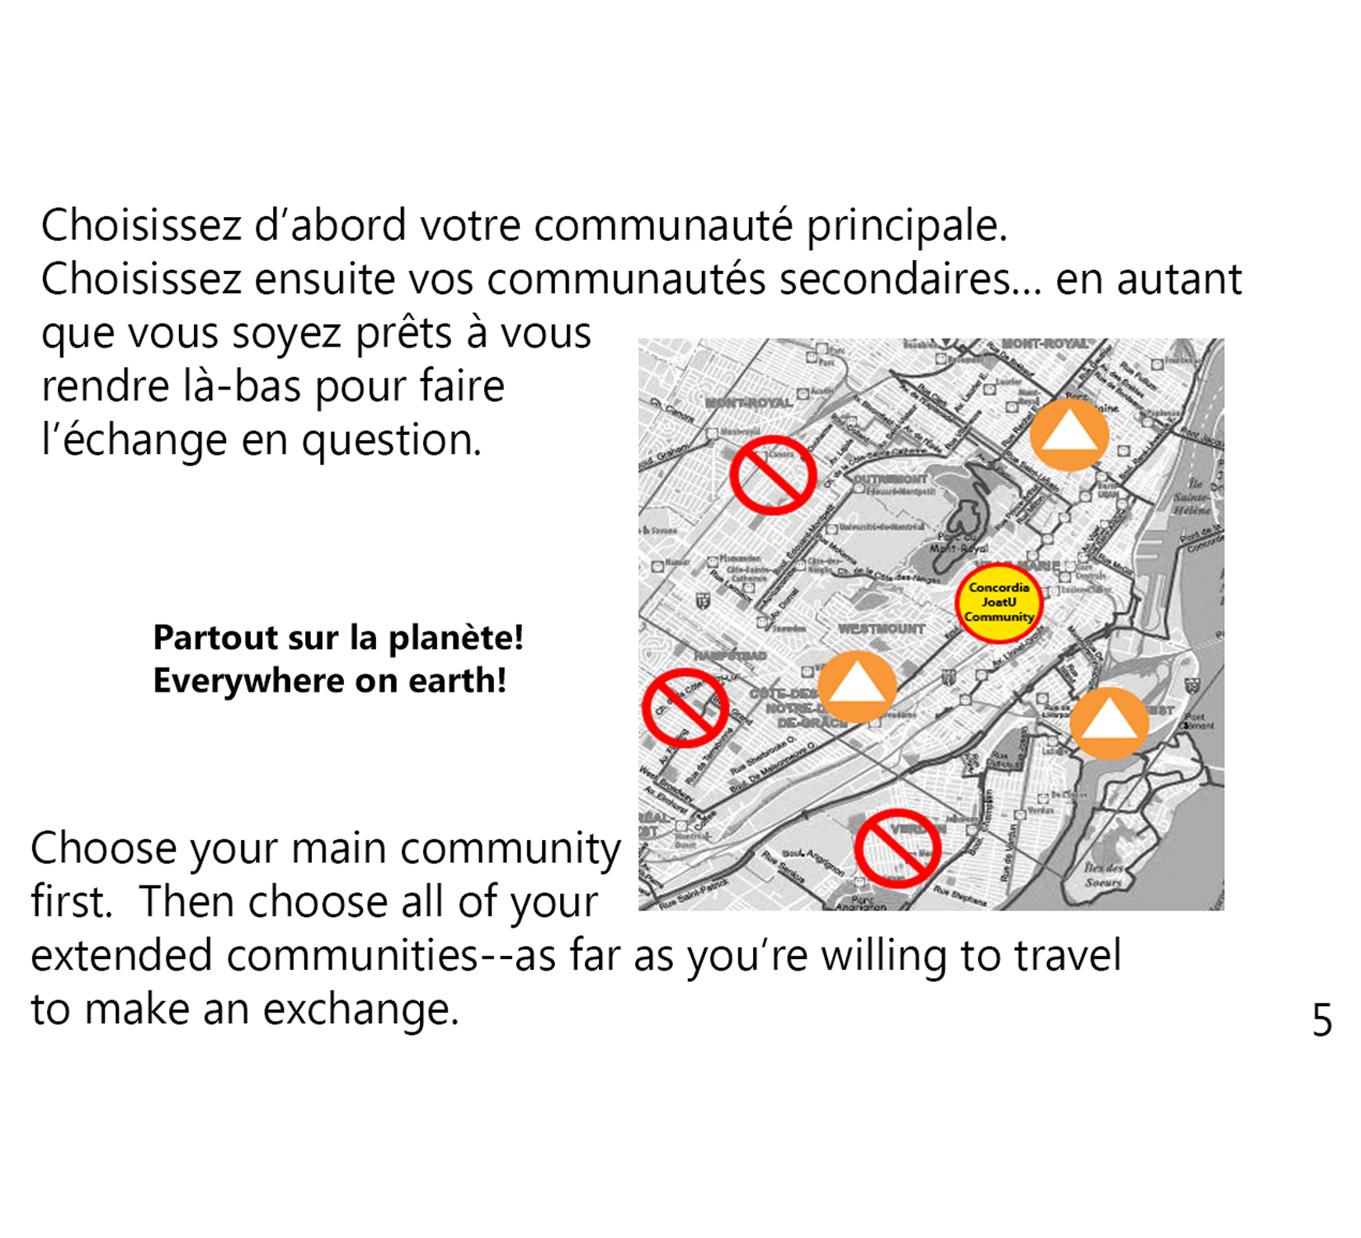

Slide 7
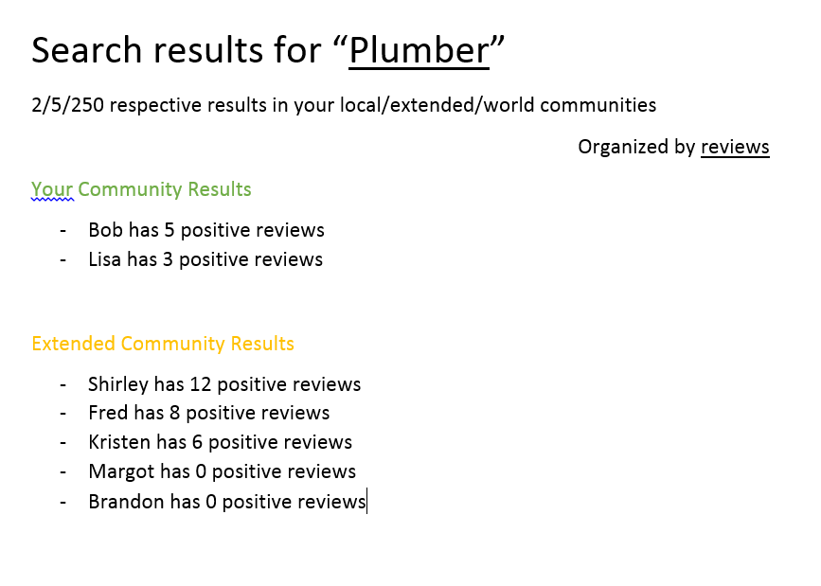

Slide 8
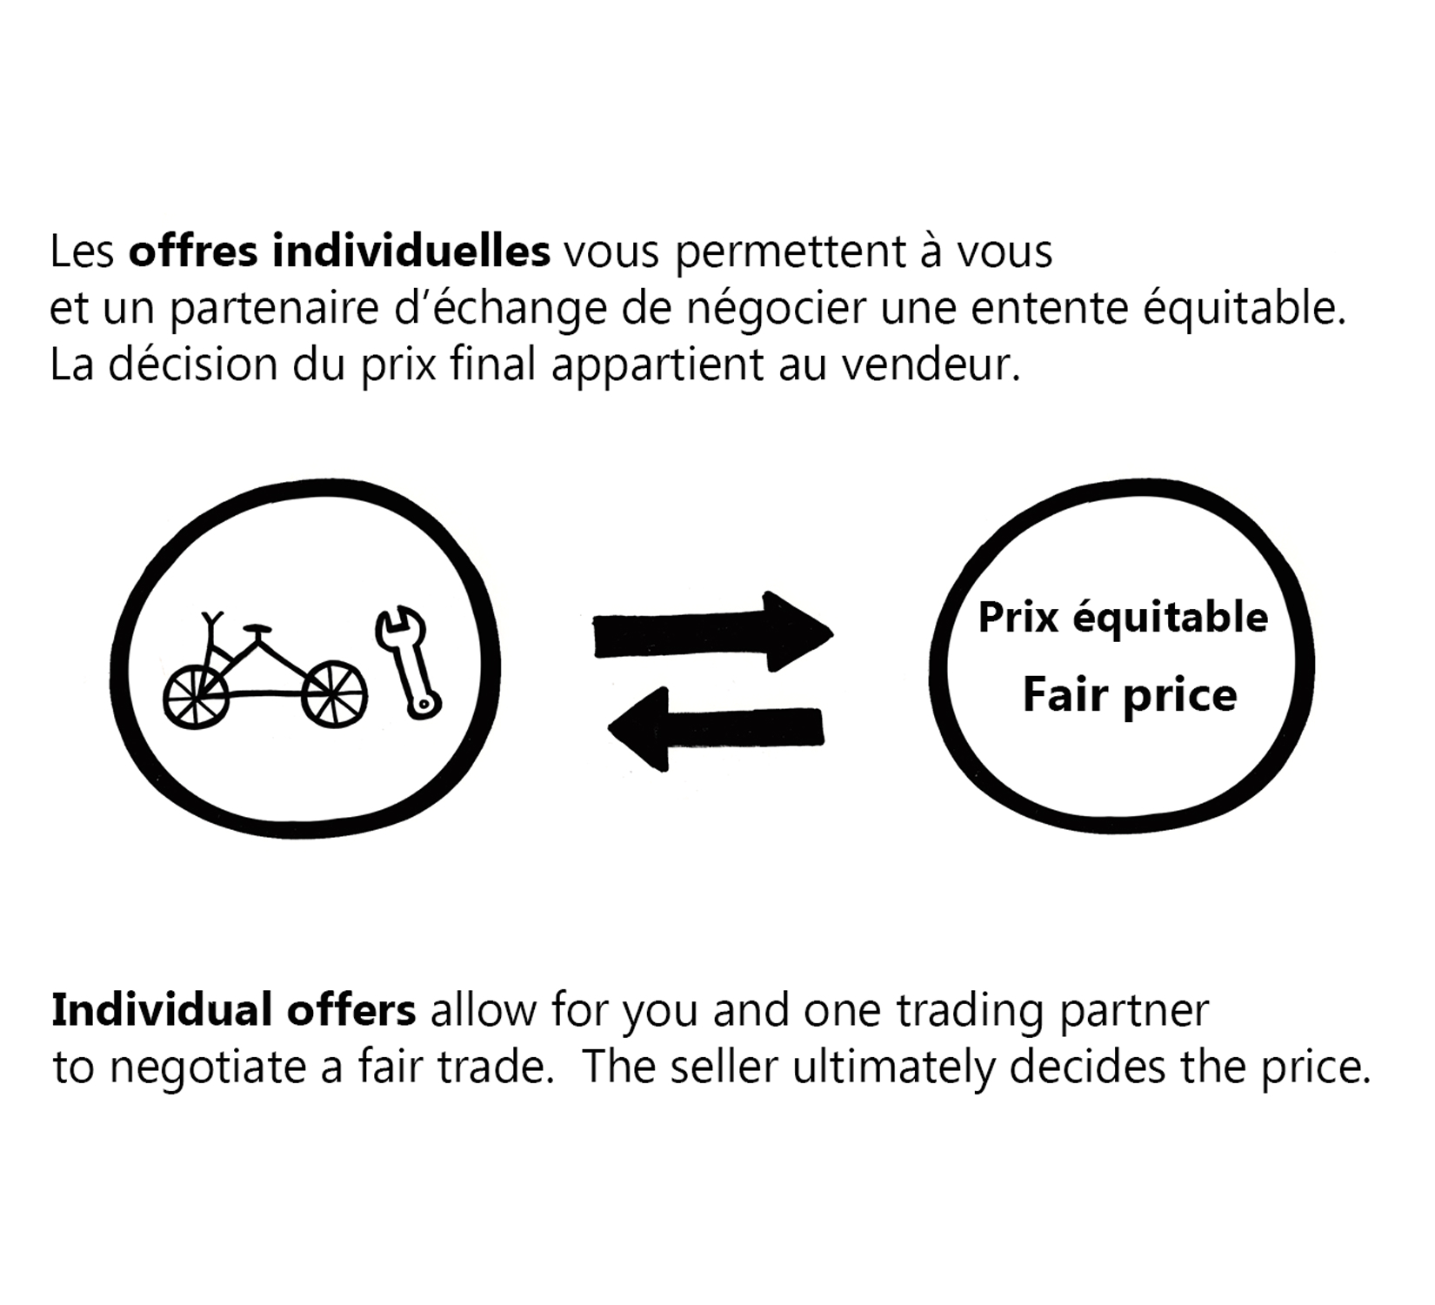

Slide 9
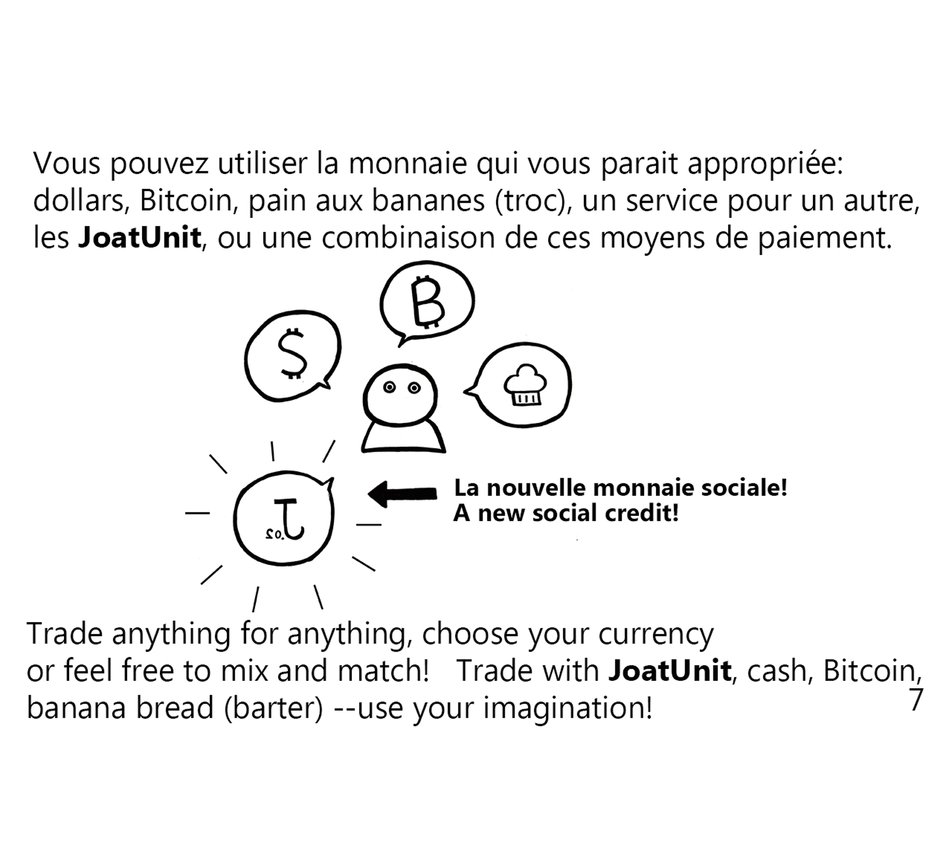

Slide 10
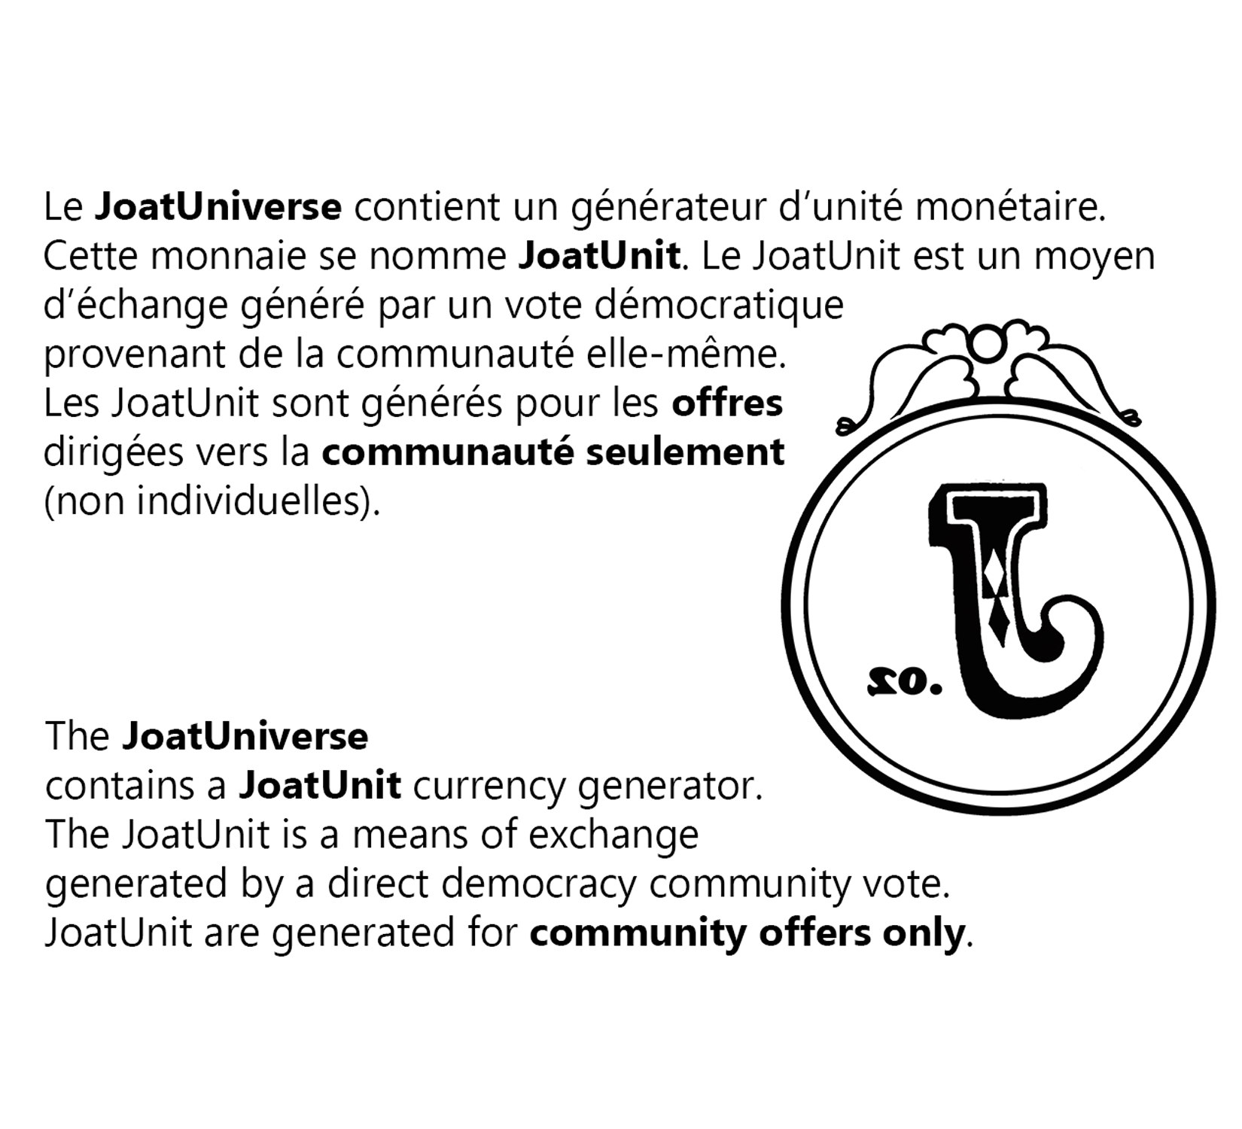

Slide 11


Slide 12
Joatunit for Community offers
JoatUnit is generated through the community offer process
Currency Traits
Permanent 0% Interest-rate
Inflationary (as compared to deflationary)
Unlimited supply of JoatUnit that can be generated
Incentive to spend & Incentive against hoarding
Increased number of exchanges & JoatUnit fluidity

Slide 13
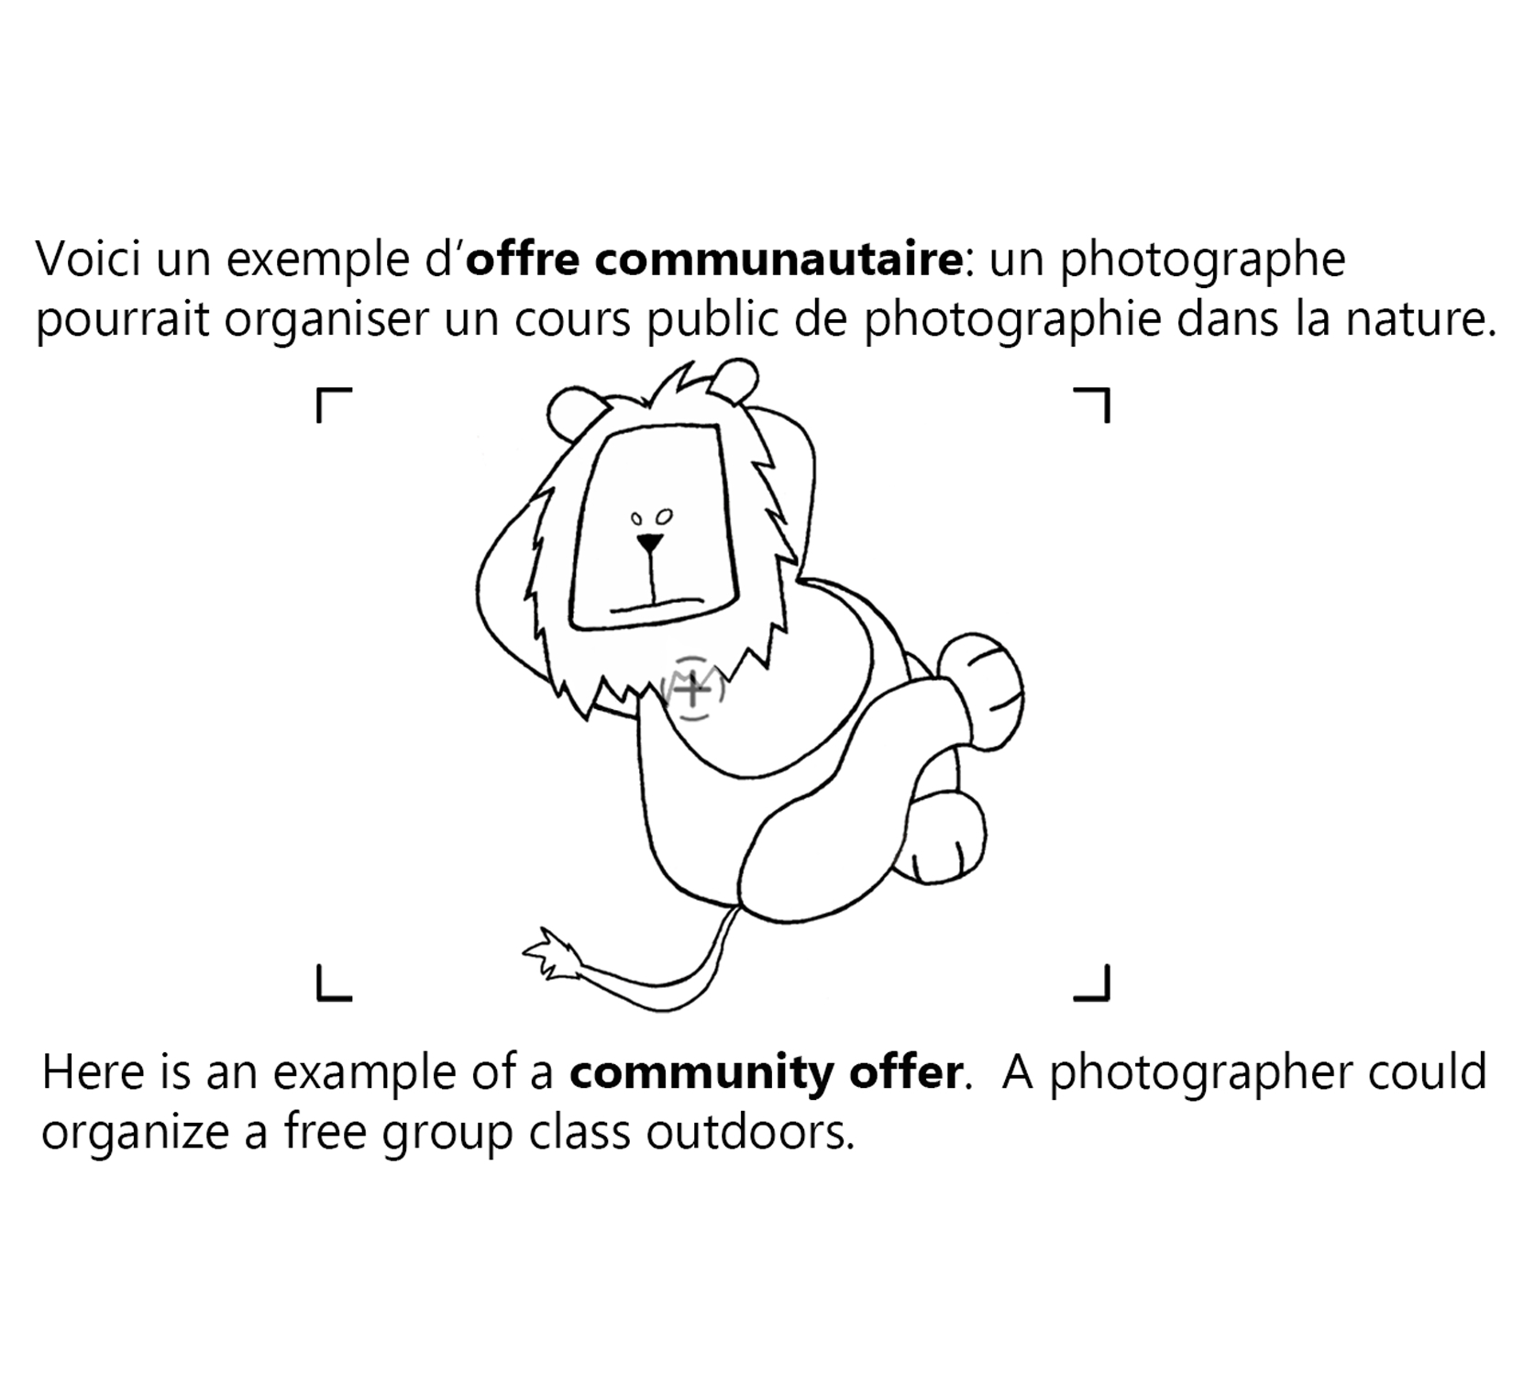

Slide 14
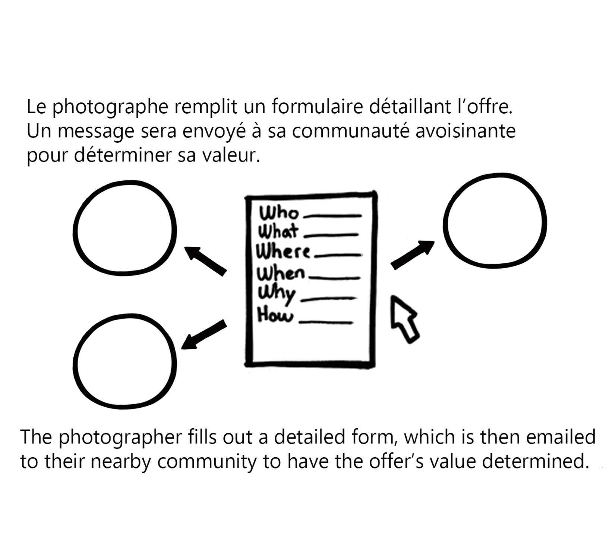

Slide 15
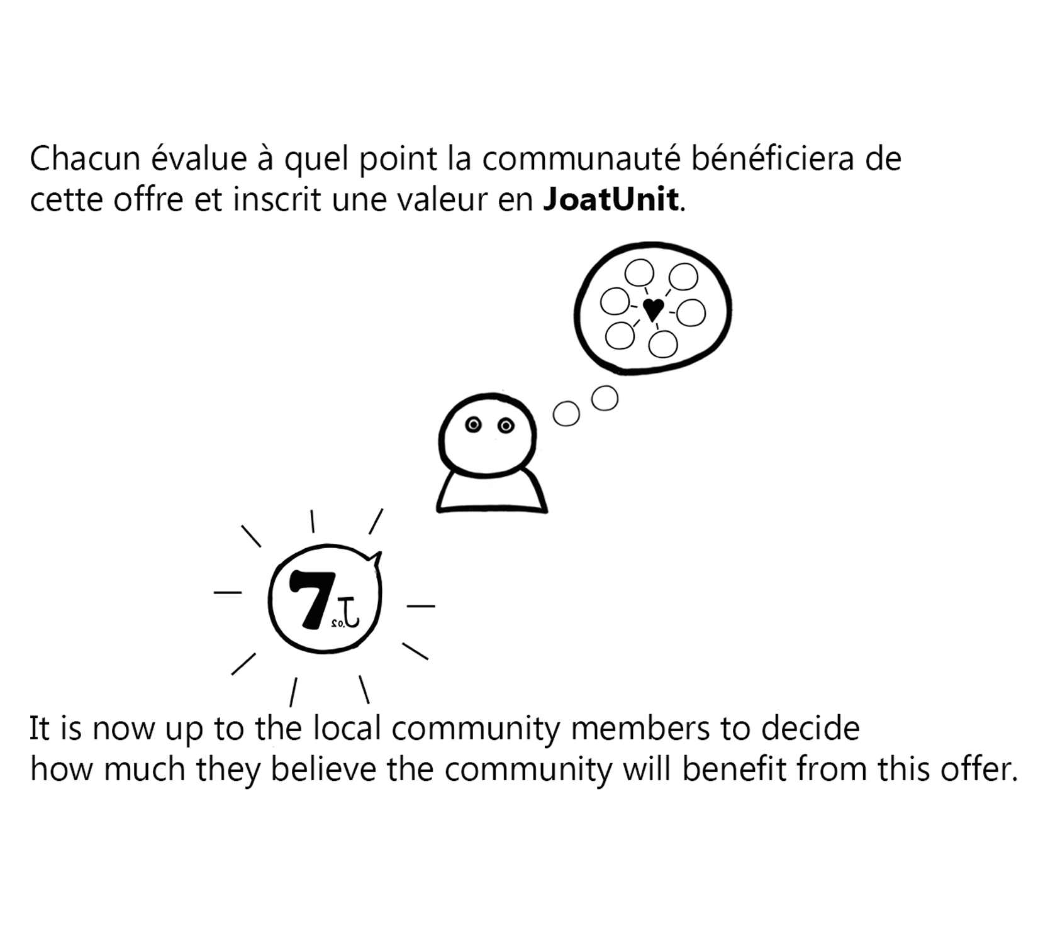

Slide 16
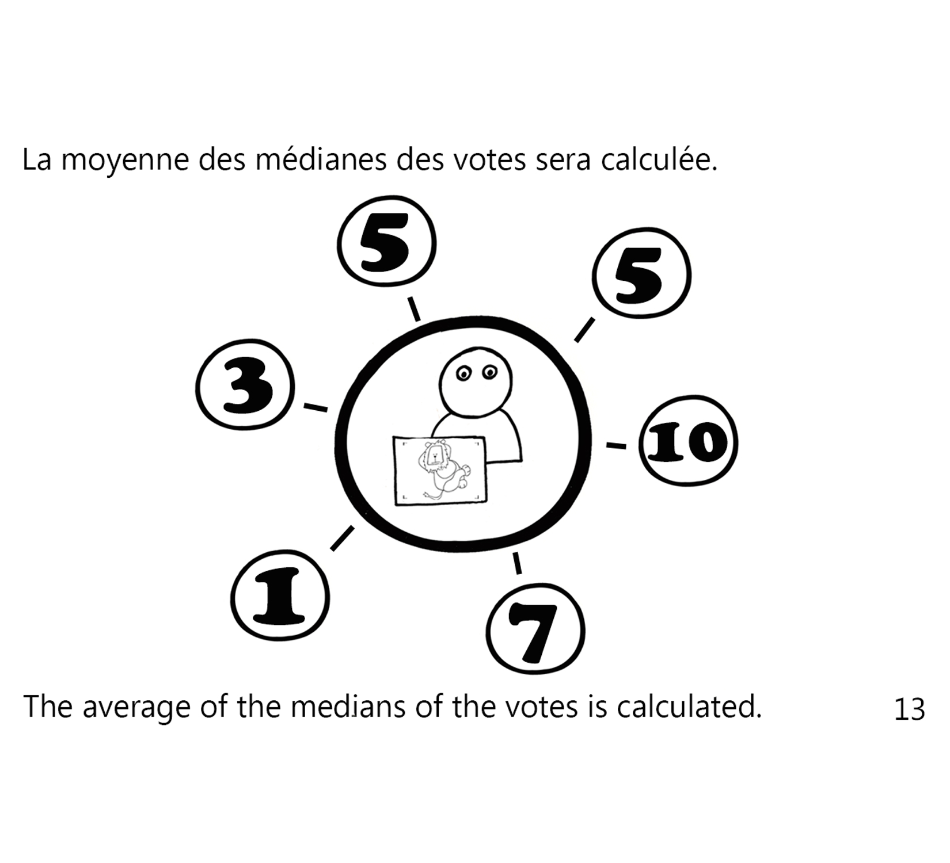
This process does not cost the voters anything!

Slide 17
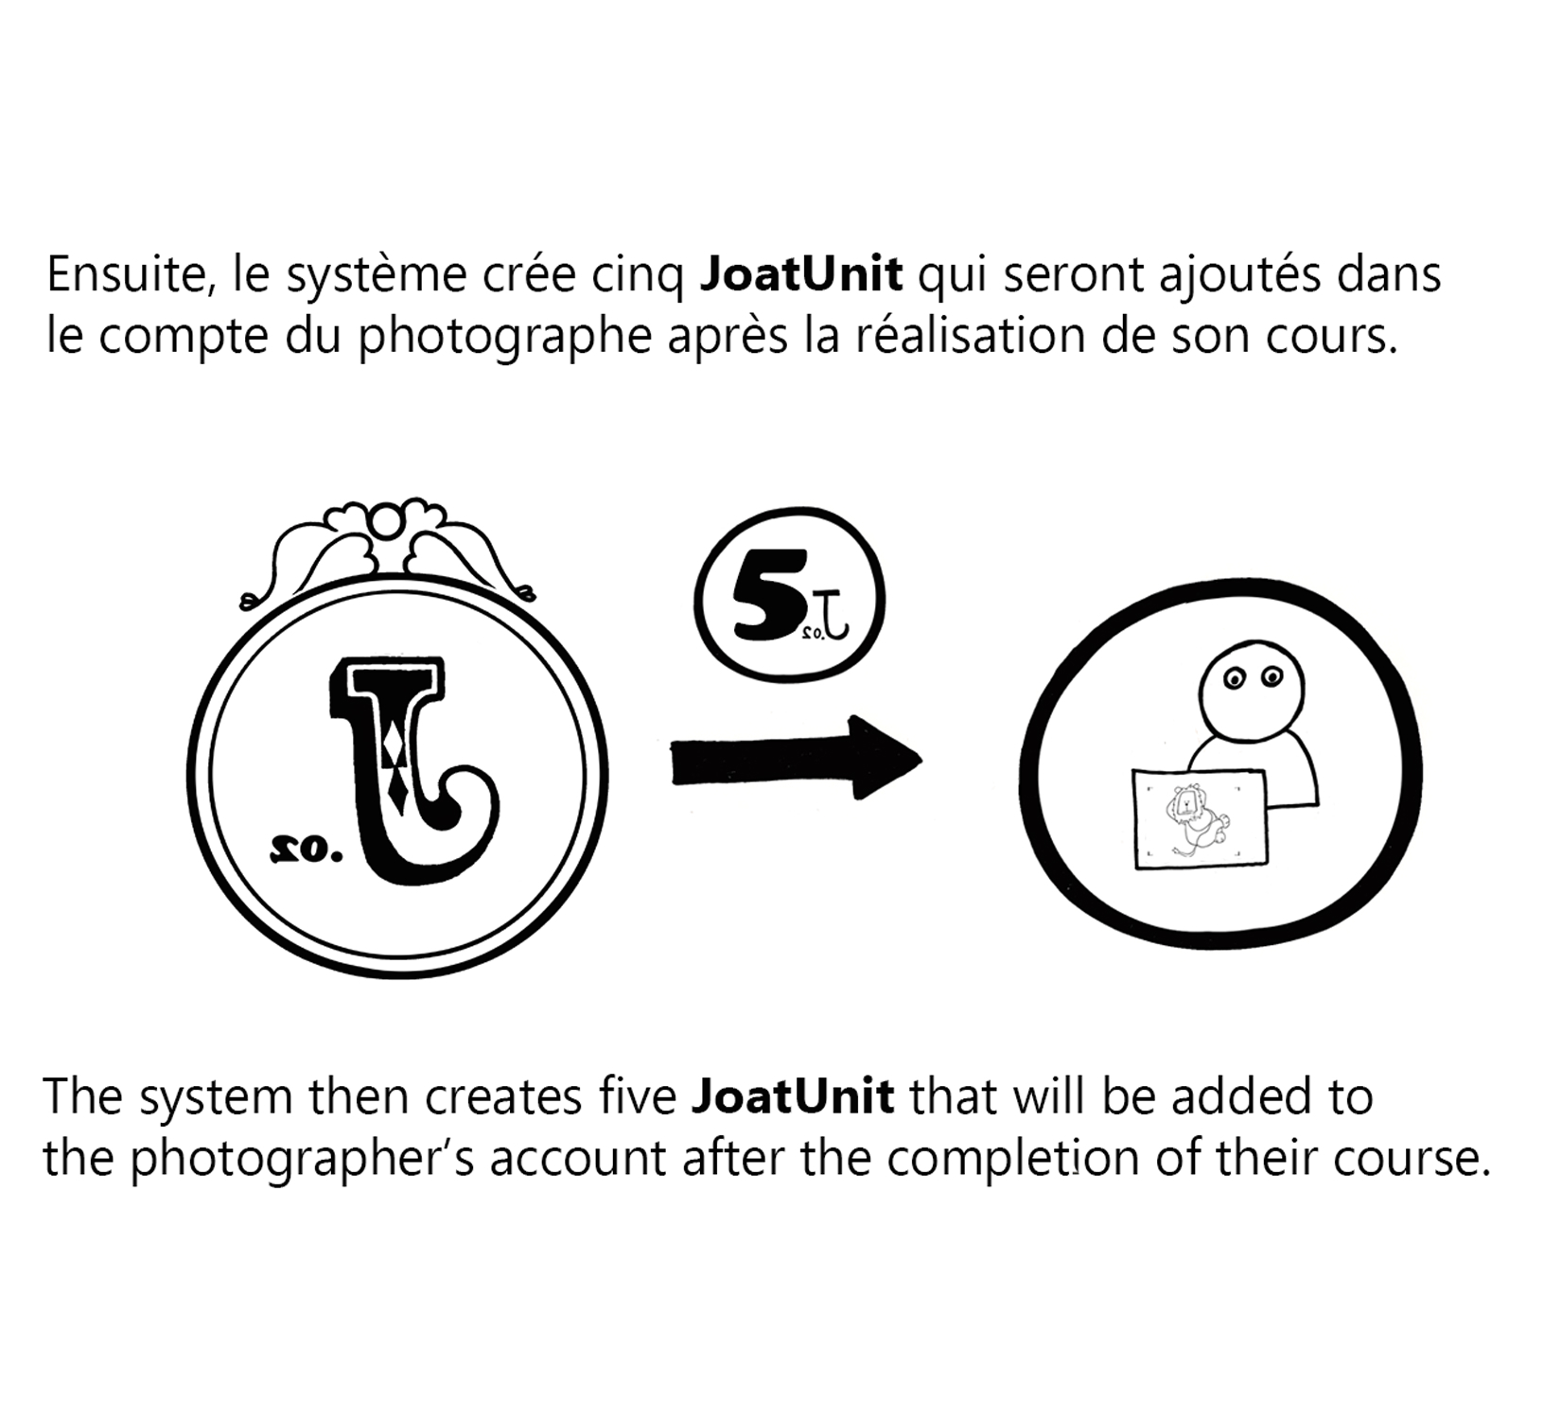

Slide 18
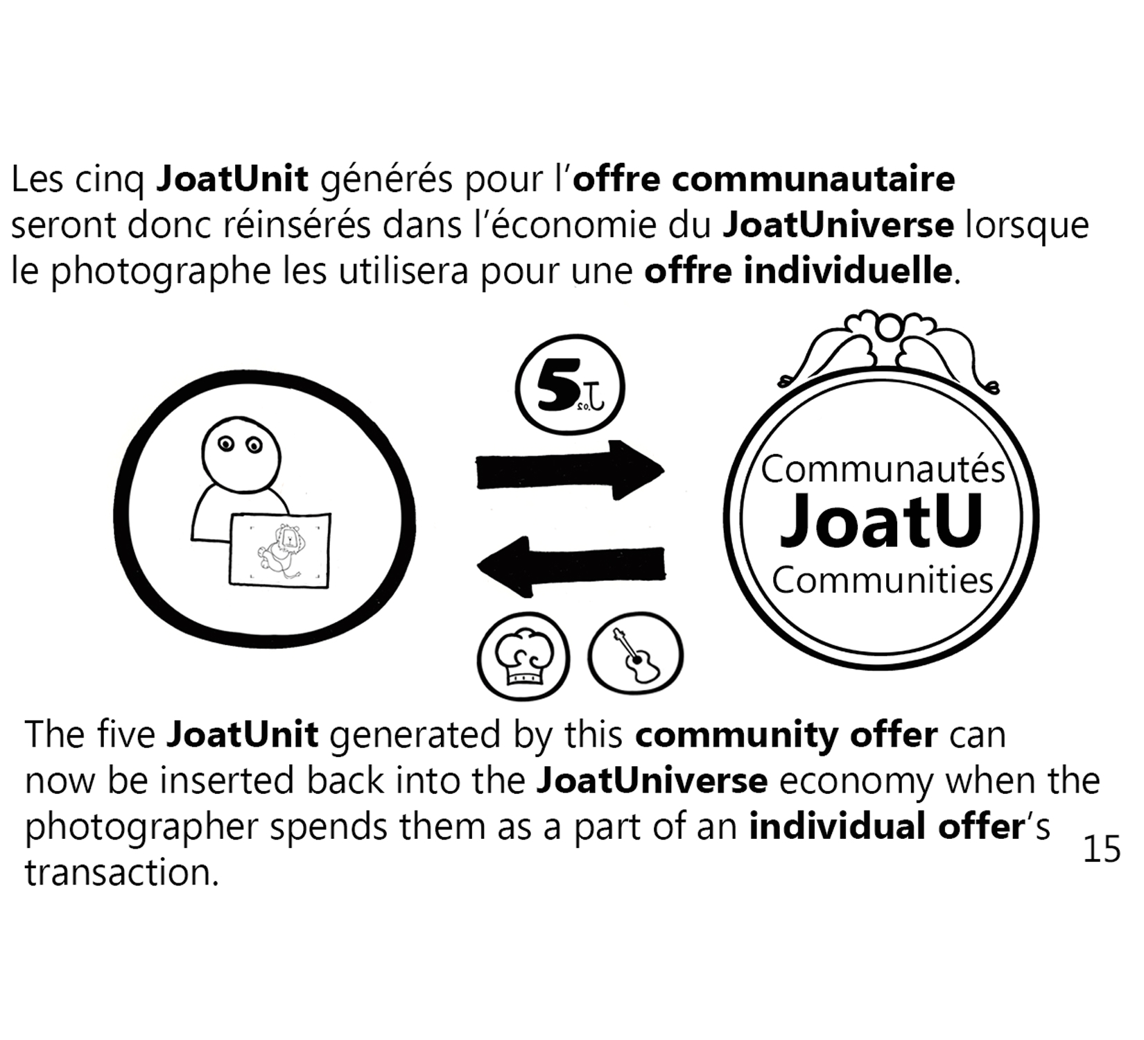

Slide 19
What can joatu hope to accomplish in 2014?
Underemployed/Unemployed → Freelancers
Increased sense of community security
Discovery of personal usefulness & purpose
Hyperlocal listing of available goods and services

Slide 20
What can joatu hope to accomplish in 2014?
Free education for students w/ paid educators
Promotion of skill acquisition, diversification & learning
Paid guerilla gardening to generate citywide free food
Hive mind for evolving value generation

Slide 21

Contact / Volunteer / Donate

Slide 22
HOW TO Participate with joatu
Email me with your skillset, interests, questions and/or CV : info@joatu.com
Like/Follow/Share on Facebook & Twitter

